Slide 1
AdaBoost

Slide 2
PPppBoost

Slide 3
Motivation for AdaBoost
Using the language of gradient descent also allows us to connect gradient boosting for regression to a boosting algorithm often used for classification, AdaBoost.
In classification, we typically want to minimize the classification error:
Naively, we can try to minimize Error via gradient descent, just like we did for MSE in gradient boosting.
Unfortunately, Error is not differentiable ☹

Slide 4
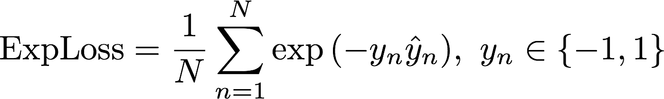
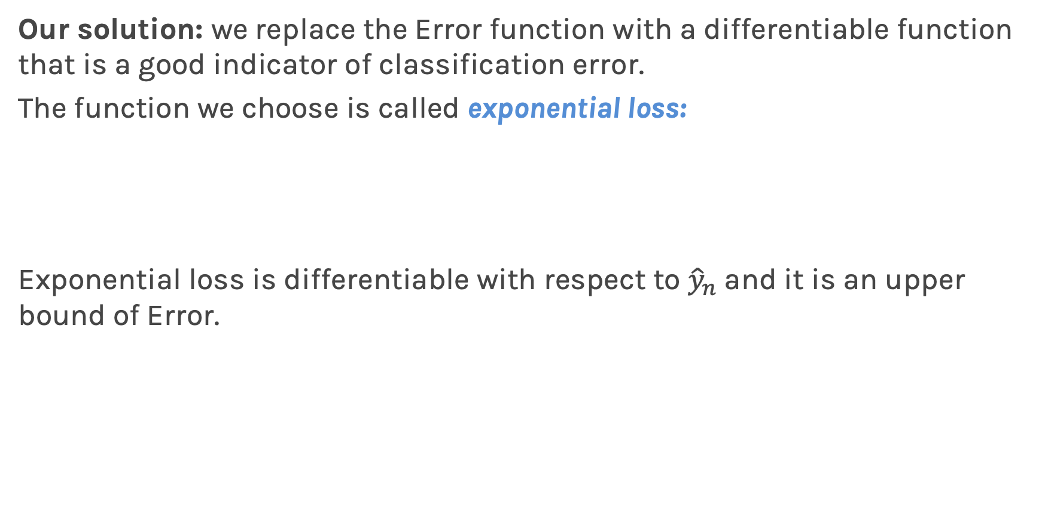
Motivation for AdaBoost (cont.)
Our solution: we replace the Error function with a differentiable function that is a good indicator of classification error.
The function we choose is called exponential loss:
Exponential loss is differentiable with respect to ${\hat{y}}_{n}$and it is an upper bound of Error.

Slide 5
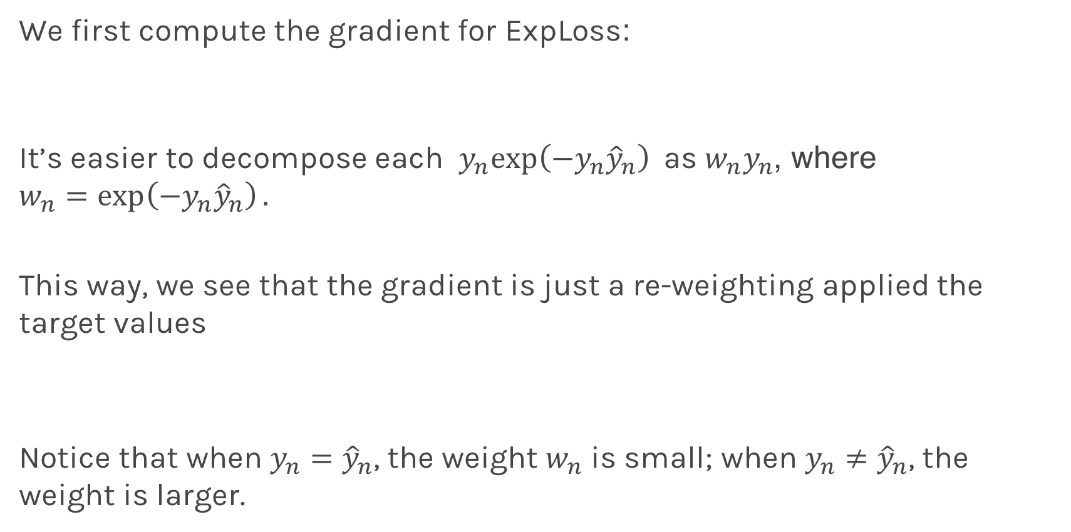
Gradient Descent with Exponential Loss
We first compute the gradient for ExpLoss:
It’s easier to decompose each $y_{n}exp\left(−y_{n}{\hat{y}}_{n}\right)$as ${w_{n}y}_{n}$, where $$w_{n}=\exp\left(−y_{n}{\hat{y}}_{n}\right).$$
This way, we see that the gradient is just a re-weighting applied the target values
Notice that when $y_{n}={\hat{y}}_{n}$, the weight $w_{n}$ is small; when $y_{n}≠{\hat{y}}_{n}$, the weight is larger.

Slide 6
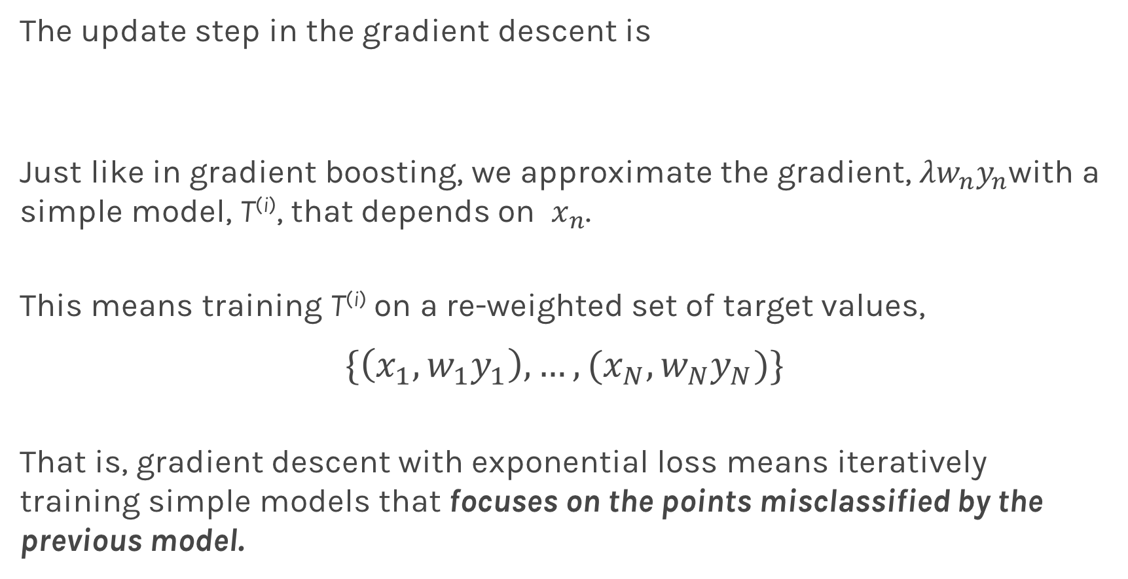
Gradient Descent with Exponential Loss
The update step in the gradient descent is
Just like in gradient boosting, we approximate the gradient, ${{λw}_{n}y}_{n}$with a simple model, T^{(i)}, that depends on $x_{n}$.
This means training T^{(i)} on a re-weighted set of target values,
$$\{\left(x_{1},w_{1}y_{1}\right),…,(x_{N},w_{N}y_{N})\}$$
That is, gradient descent with exponential loss means iteratively training simple models that focuses on the points misclassified by the previous model.
$${\hat{y}}_{n}←{\hat{y}}_{n}+λw_{n}y_{n}, n=1,…, N$$

Slide 7
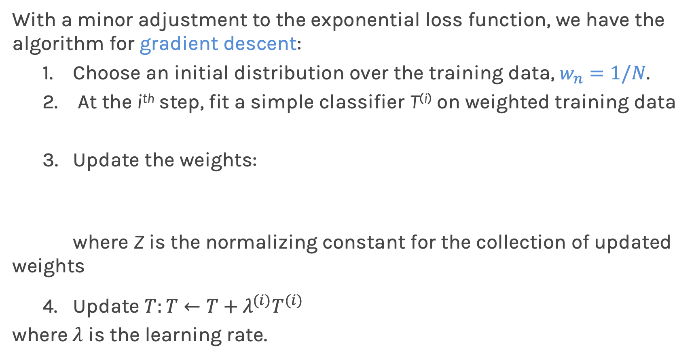
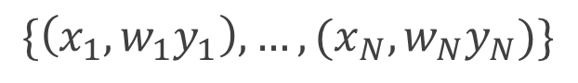
AdaBoost
With a minor adjustment to the exponential loss function, we have the algorithm for gradient descent:
1. Choose an initial distribution over the training data, $w_{n}=1/N$.
2. At the i^{th} step, fit a simple classifier T^{(i)} on weighted training data
3. Update the weights:
where Z is the normalizing constant for the collection of updated weights
4. Update $T:T←T+λ^{(i)}T^{(i)}$
where $λ$ is the learning rate.
$$\{\left(x_{1},w_{1}y_{1}\right),…,(x_{N},w_{N}y_{N})\}$$

Slide 8
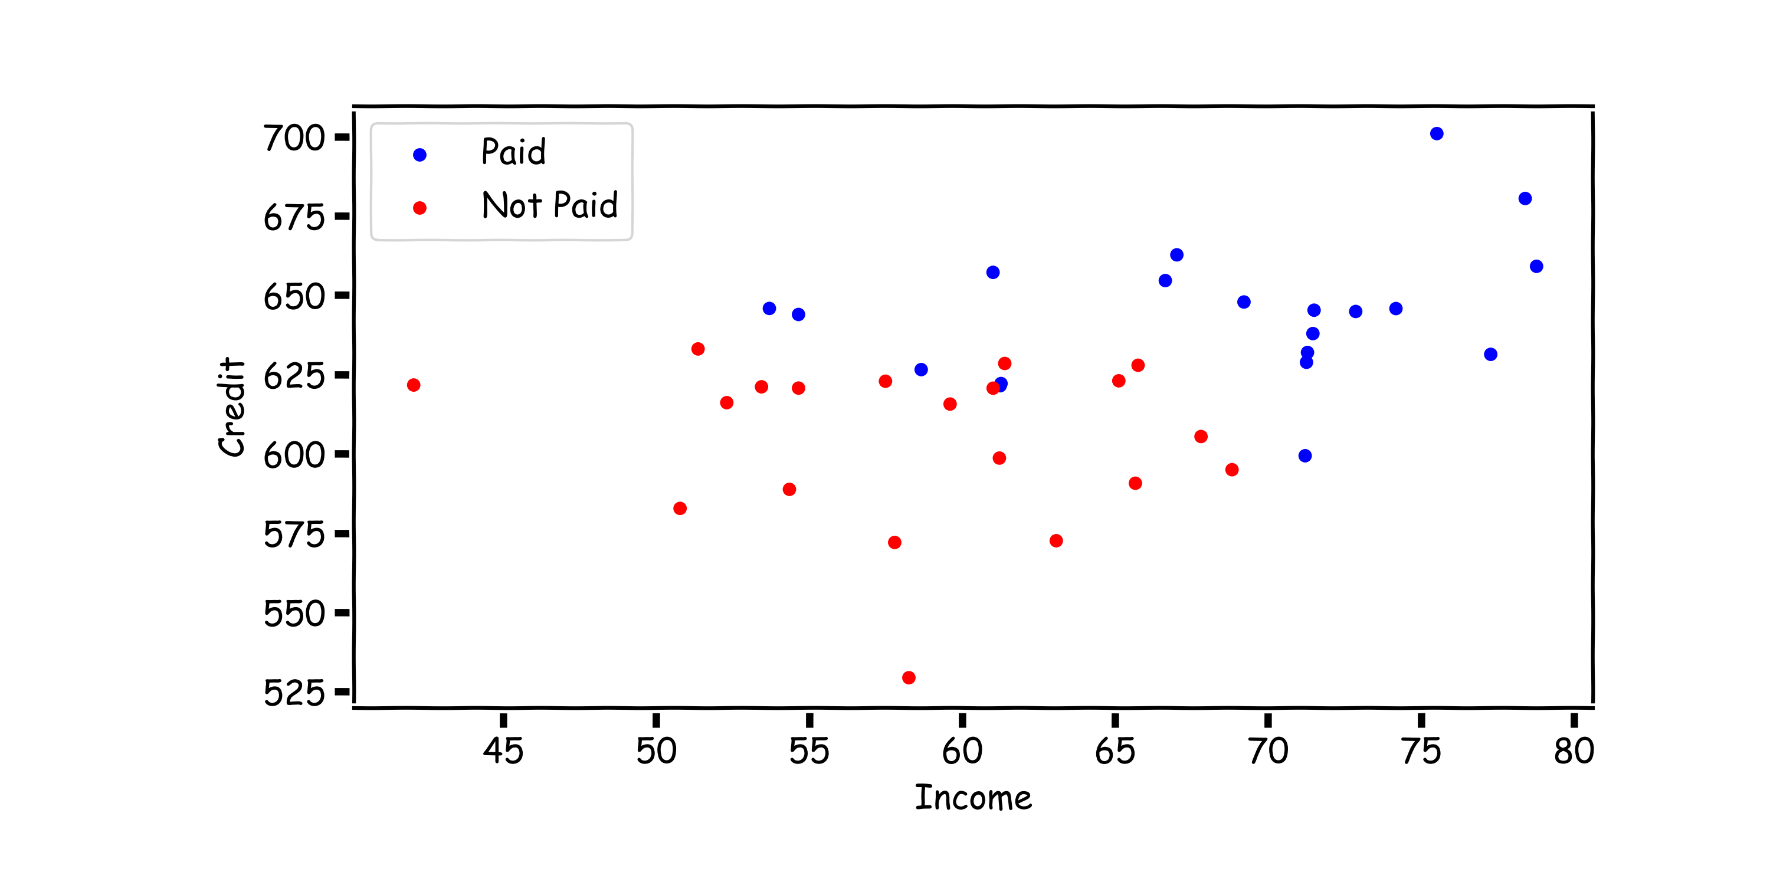
AdaBoost: start with equal weights

Slide 9
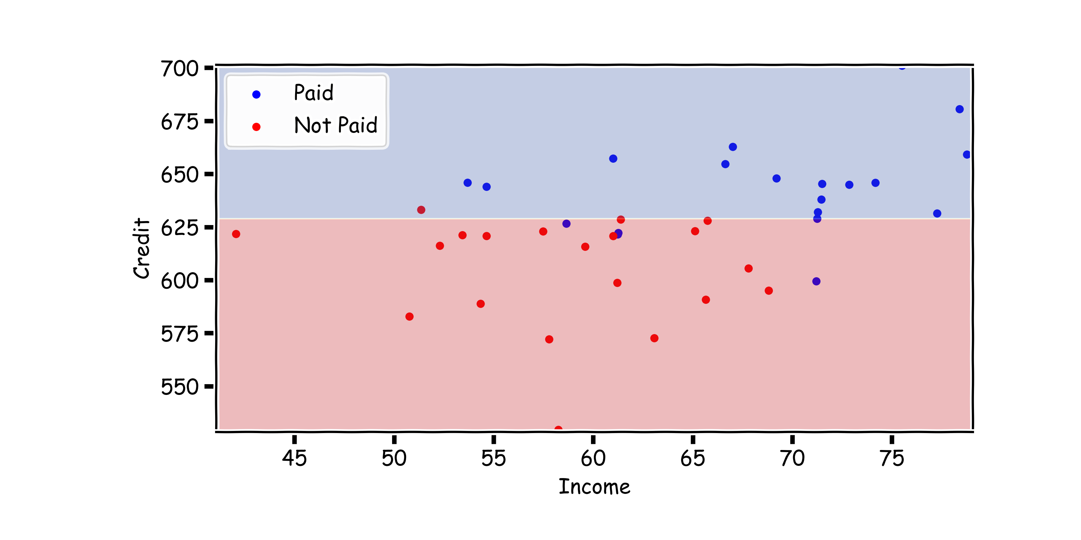
AdaBoost: fit a simple decision tree
fit a simple classifier T^{(i)}

Slide 10
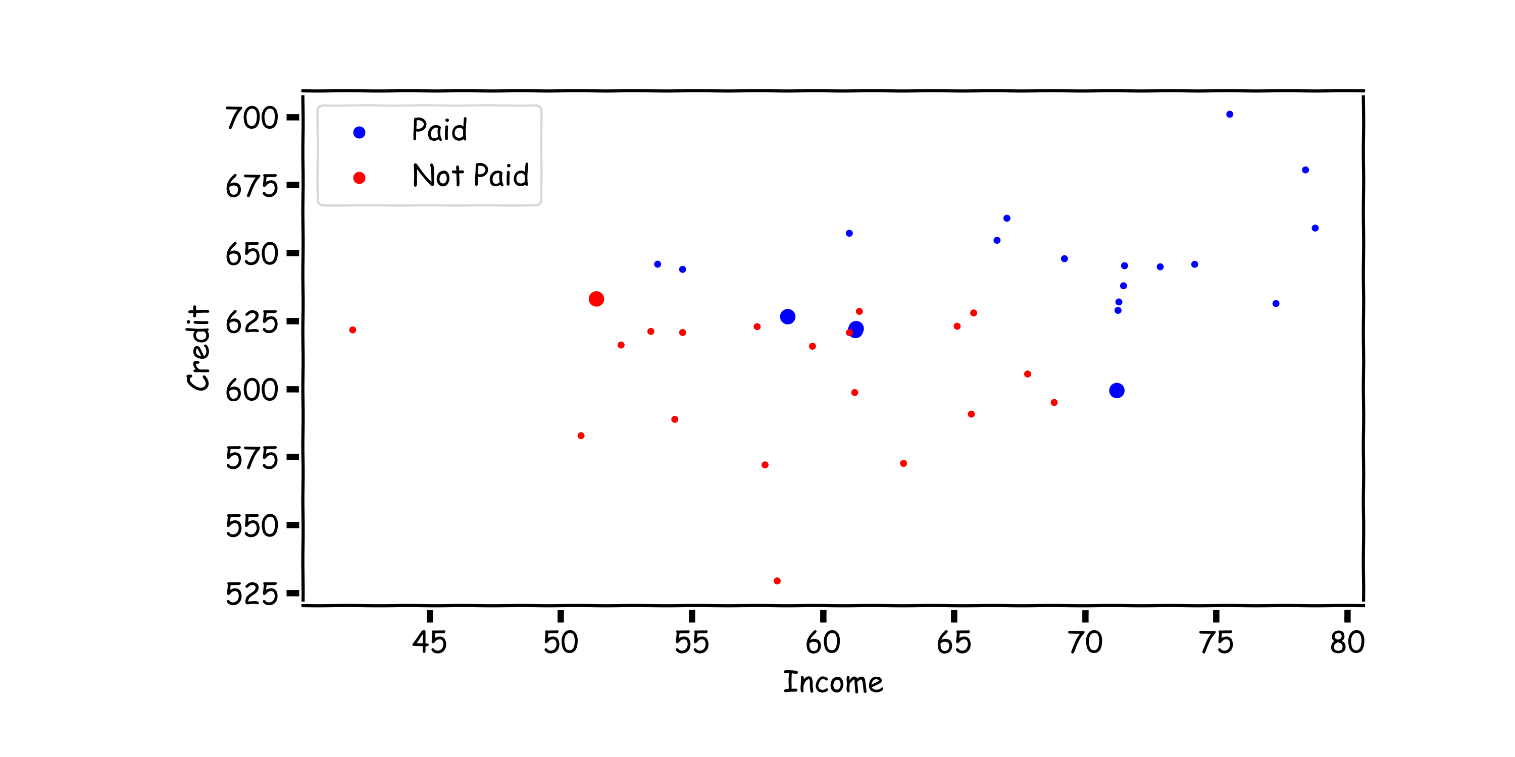
AdaBoost: update the weights
Update the weights:

Slide 11
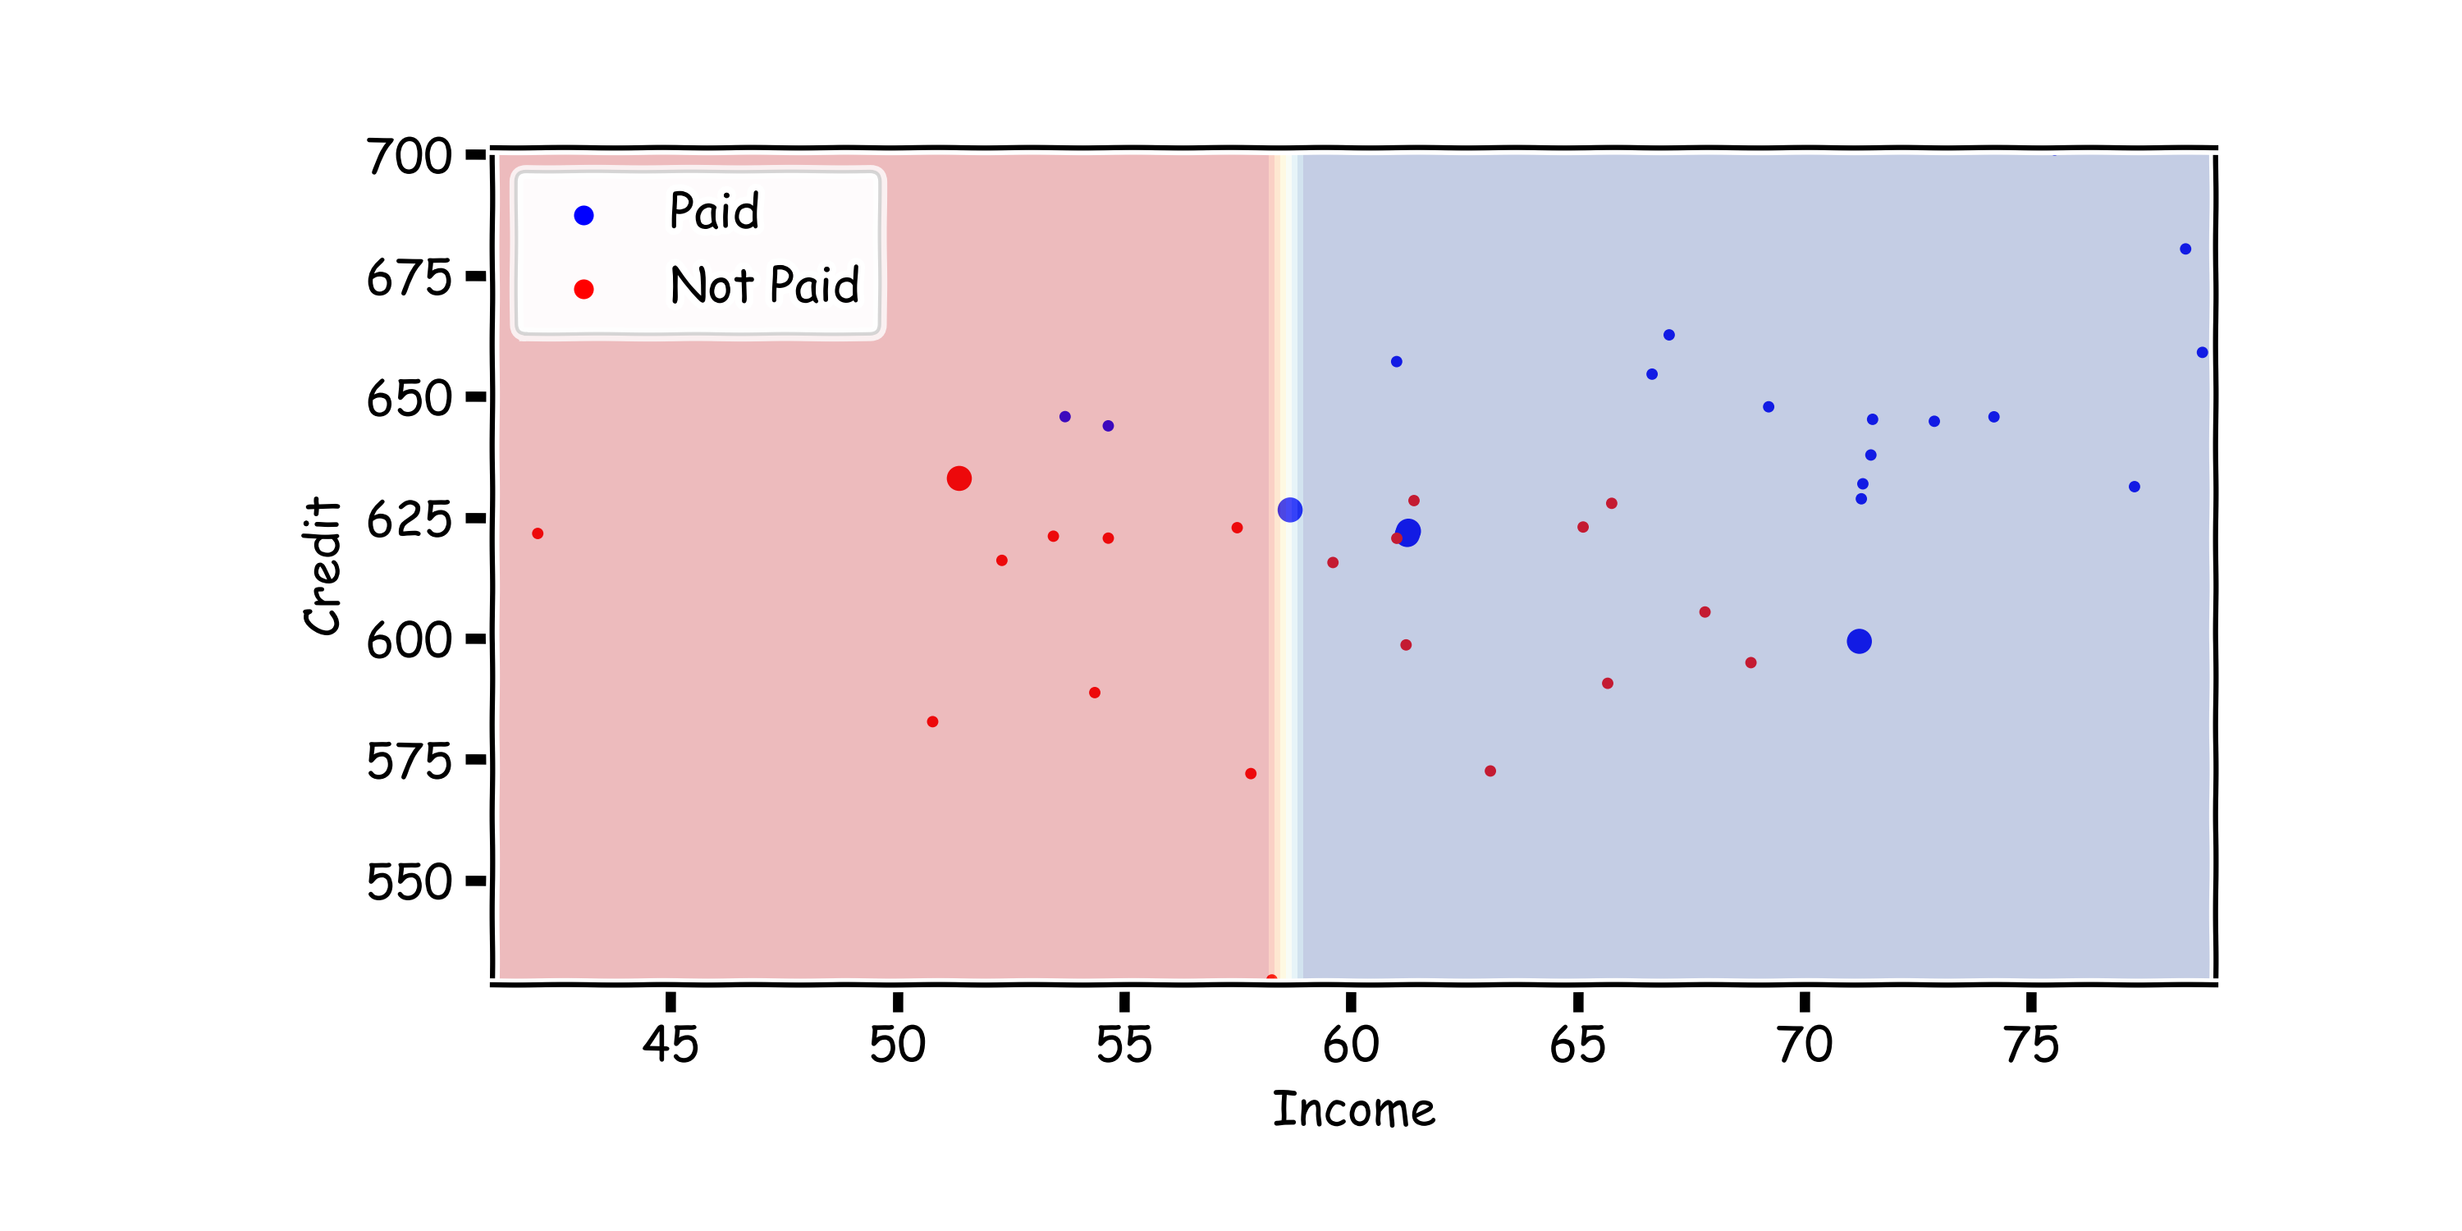
AdaBoost:
fit another simple decision tree on re-weighted data

Slide 12
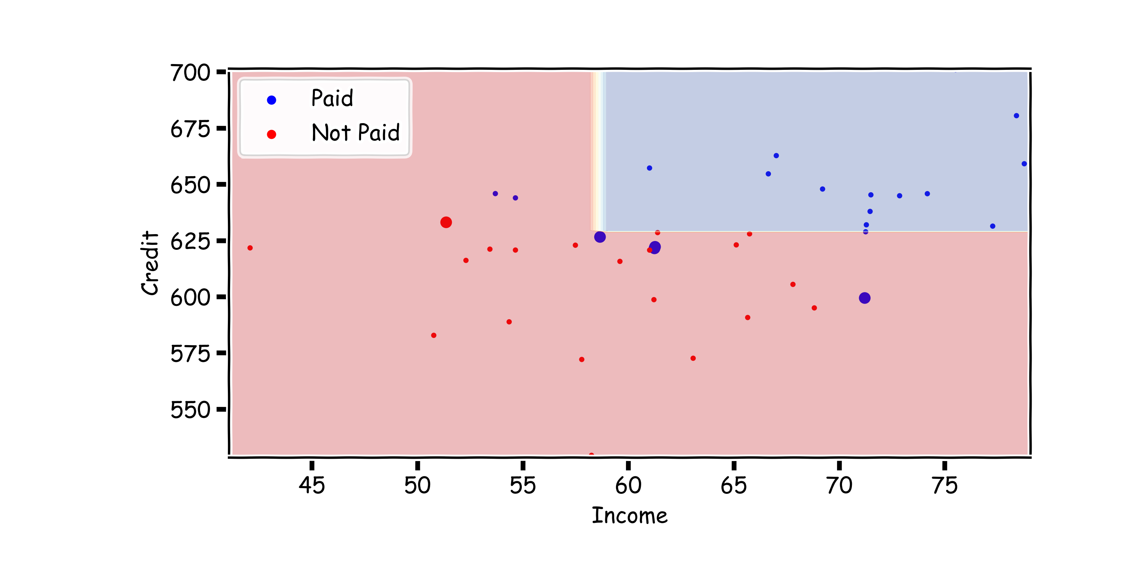
AdaBoost:
$$\text{add} \text{the} \text{new} \text{model} \text{to} \text{the} \text{ensemble}\text{: }T←T+λ^{(i)}T^{(i)}$$

Slide 13
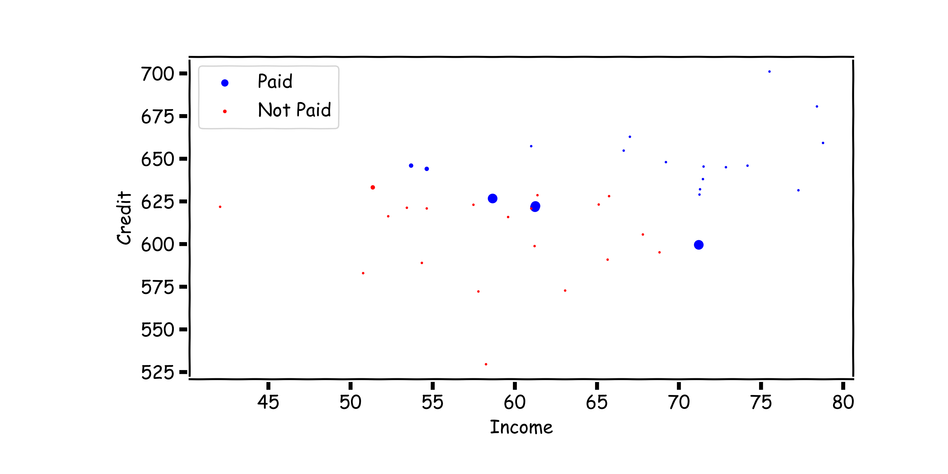
AdaBoost: update the weights
Update the weights:

Slide 14
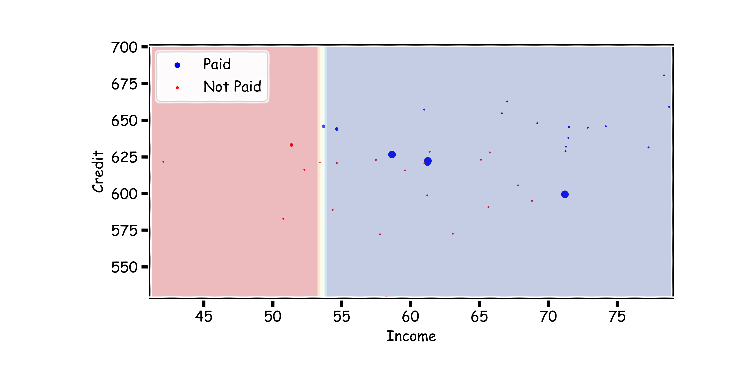
AdaBoost
fit another simple decision tree on re-weighted data

Slide 15
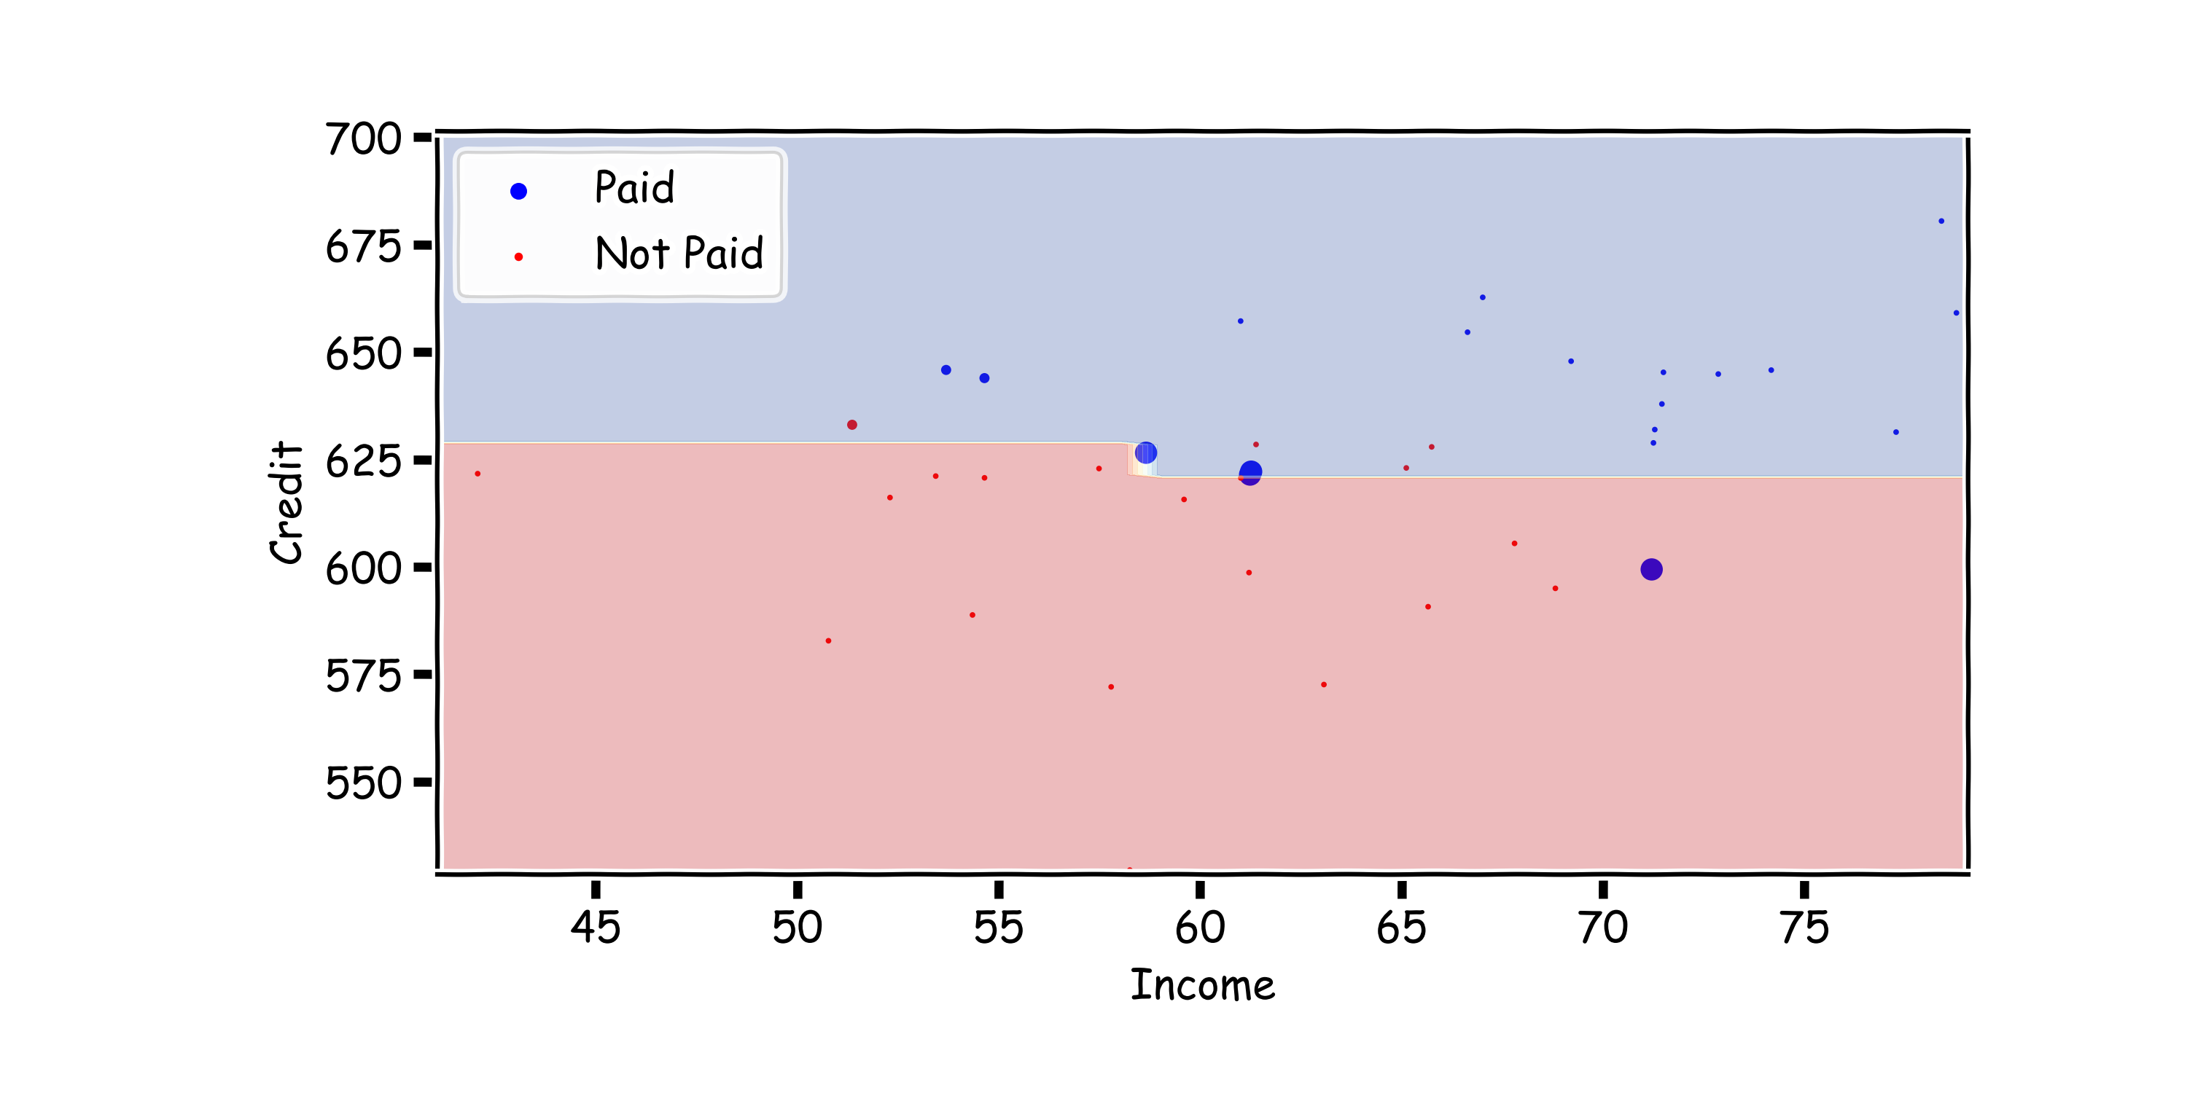
AdaBoost: add the new model to the ensemble, repeat…
$$\text{add} \text{the} \text{new} \text{model} \text{to} \text{the} \text{ensemble}\text{: }T←T+λ^{(i)}T^{(i)}$$

Slide 16
Choosing the Learning Rate
Unlike in the case of gradient boosting for regression, we can analytically solve for the optimal learning rate for AdaBoost, by optimizing:
Doing so, we get that

Slide 17
Final thoughts on Boosting
There are few implementations on boosting:
XGBoost: An efficient Gradient Boosting Decision
LGBM: Light Gradient Boosted Machines. It is a library for training GBMs developed by Microsoft, and it competes with XGBoost
CatBoost: A new library for Gradient Boosting Decision Trees, offering appropriate handling of categorical features

Slide 18
Final thoughts on Boosting
Increasing the number of trees can lead to overfitting.
Question: Why?

Slide 19
Today’s lucky student: PAVLOS AdaBoost in action

